Slide 1
Comparison of NOBO Resource Selection at Varying Spatial and Temporal Scales
Figures using dwplot() in the ggplot2 package in R

Slide 2
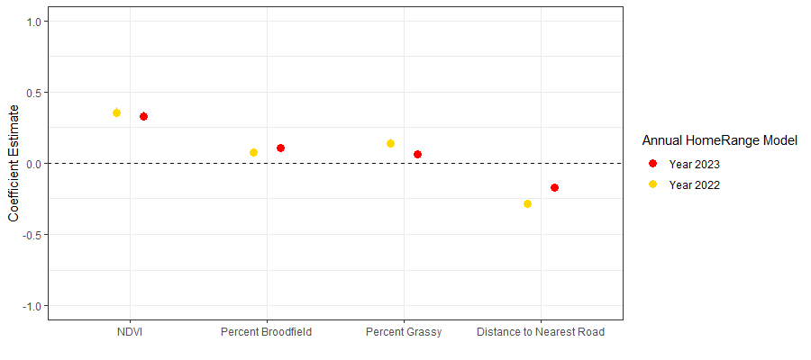
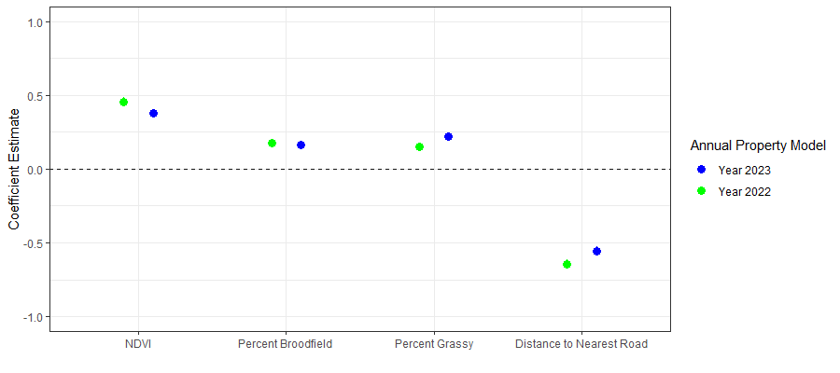
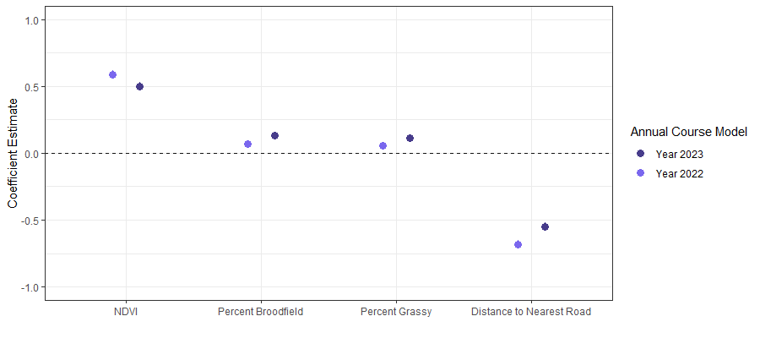
ANNUAL
Overall Takeaway: Select for NDVI, BF, Roads and Grassy
Noticed Differences: At the homerange level, the magnitude of effect of roads is less than the other spatial levels

Slide 3
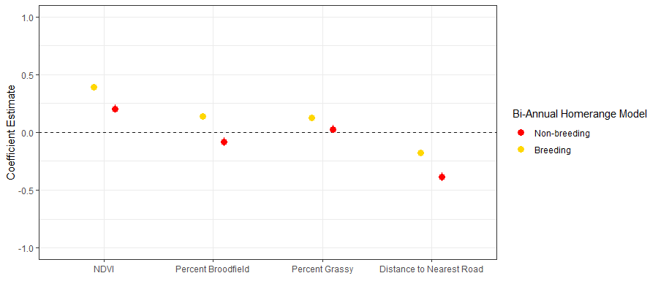
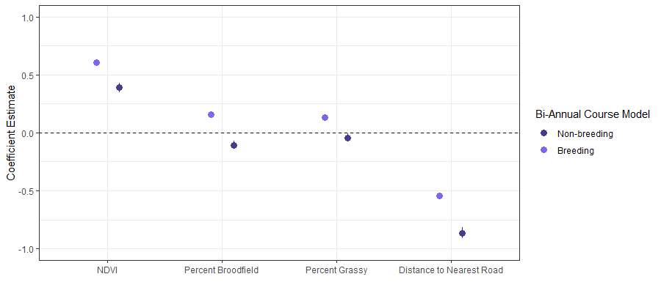
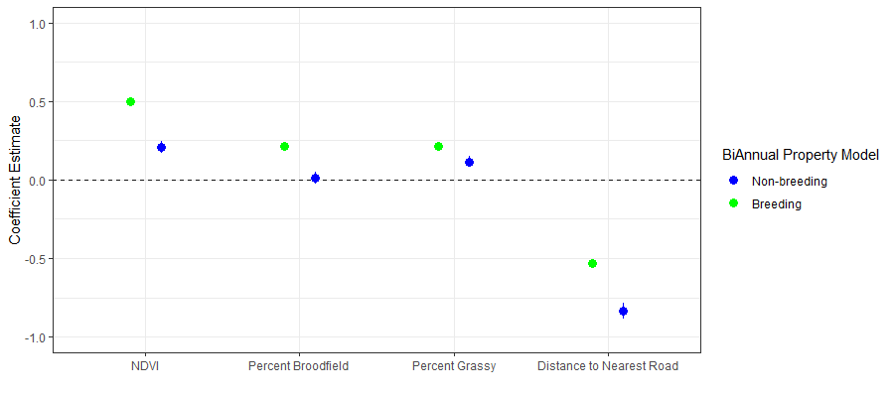
Breeding vs Nonbreeding
Overall Takeaway: Select for NDVI, BF, Roads, and Grassy
Grassy, ndvi, bf Matter most in the breeding season
Noticed Differences: At the homerange level, the magnitude of effect of roads is less than the other spatial levels
MCP
Course
Same Magnitude of effect
Property
Roads Matter most in the non-breeding season

Slide 4
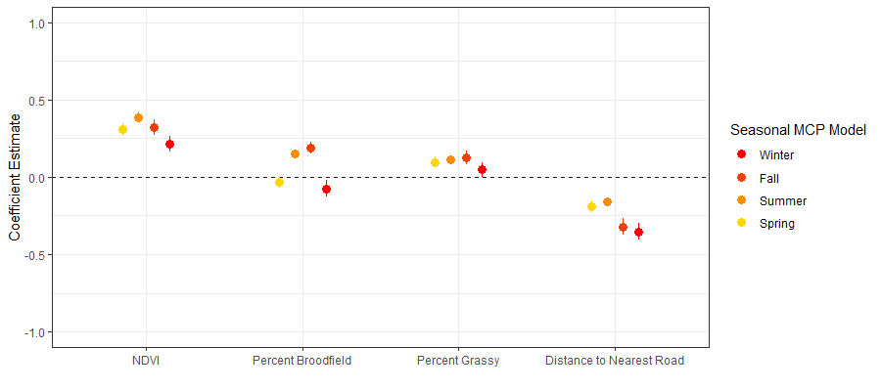
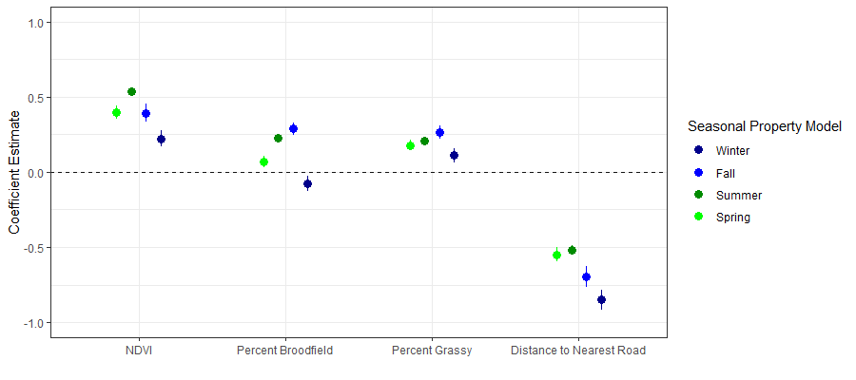
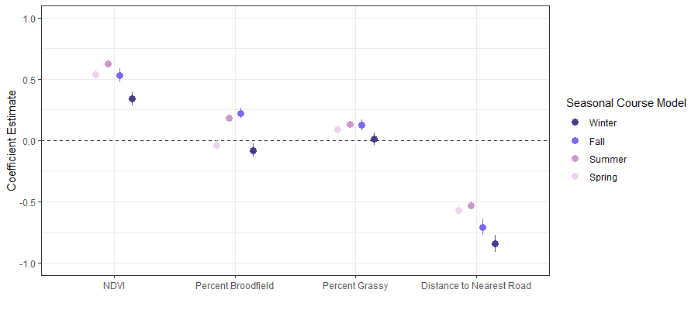
Seasonal
Still Overall selecting for higher NDVI and to be close to roads
MCP
Still see that the birds are selecting for roads less at the homerange scale while property and course are very similar
Course
At a property level, birds begin to select for BF in the spring, yet are still selecting against it at both homerange and course level
Property
Beginning to select against BF at all spatial scales in the winter

Slide 5
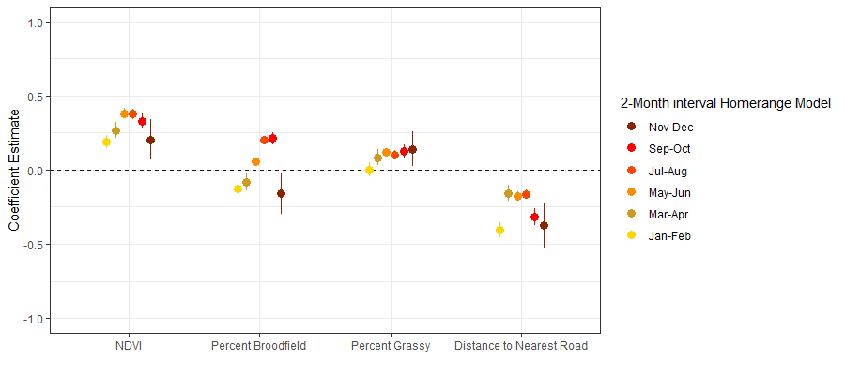
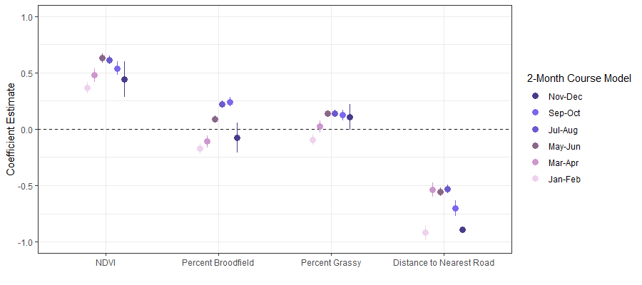
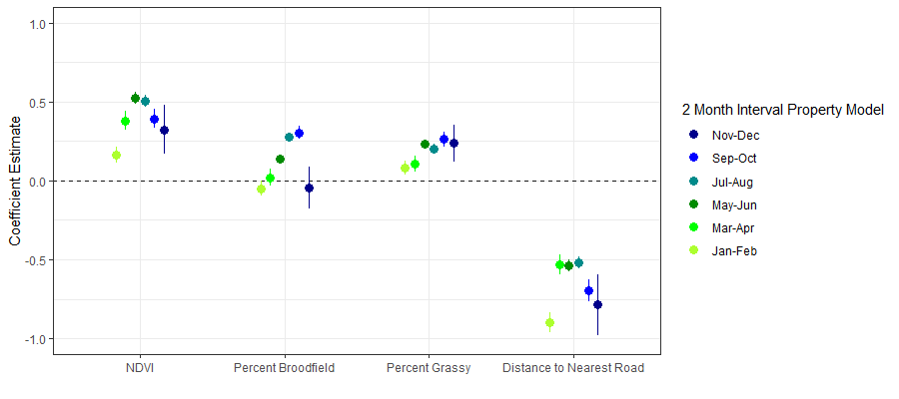
2-month Interval
MCP
Still Overall selecting for higher NDVI and to be close to roads
Jan – Feb Spatial scale potentially matters
Selected
Either/or
Against
Course
Property
Course = Property

Slide 6
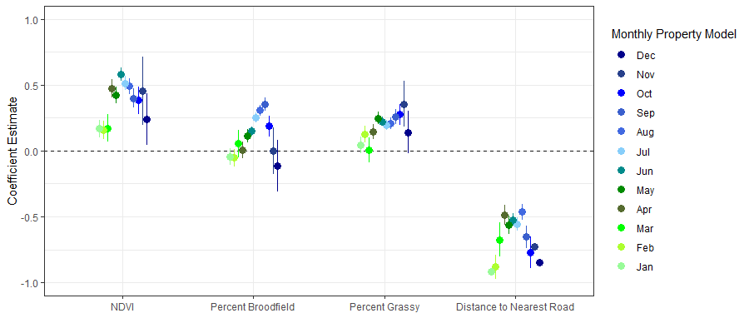
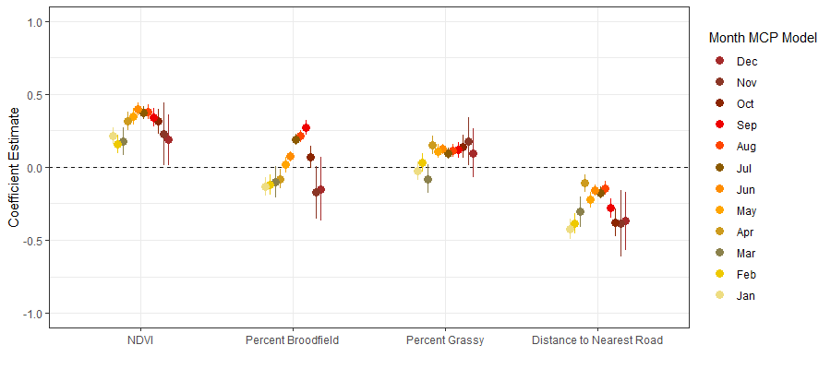
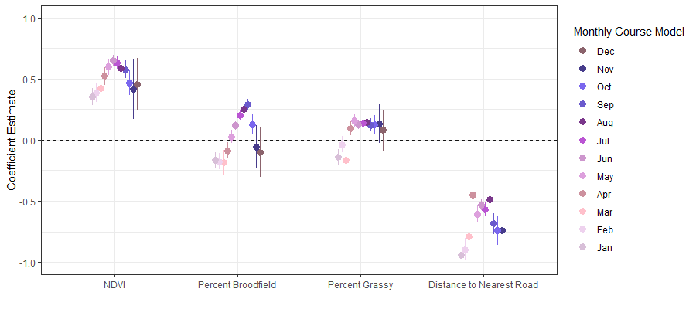
Monthly
Property
MCP
Course

Slide 7
Distance to nearest road have about the same magnitude of effect at the course and property level potentially regardless of temporal scale, however at the homerange level it seems to have less impact (although they are still selecting for it)

